Slide 1
Cybersecurity in the Education Industry
2022 Data, 2023 Trends, and the Regulatory Landscape

Slide 2
Cybersecurity in the Education Industry
Level-Set
2022 Looking Back
2023 Looking Forward
Data Protection Regulations & Resources
Jamaica Data Protection Act, 2020
Practical Advice
The Silver Lining
Additional Information
2022 Data, 2023 Trends, and the Regulatory Landscape

Slide 3
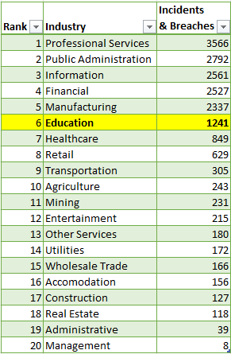
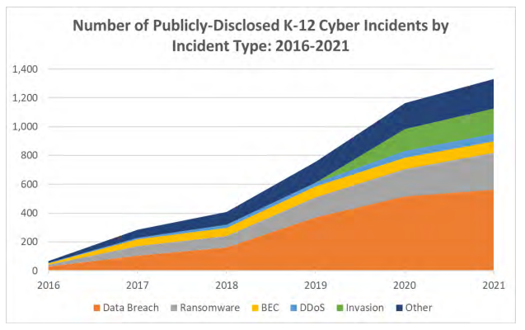
Level-Set
Notes:
Intent of this slide is to level-set the audience regarding cyber threats in the education industry:
Education is not in the top 5 targets by industry. But it’s not at the bottom, either.
LEFT GRAPHIC: Cybersecurity incidents & breaches by industry; education is in the upper middle of the list. (worldwide)
RIGHT GRAPHIC: The increase in K12 cyber incidents (by type) over time. (US only)

Slide 4
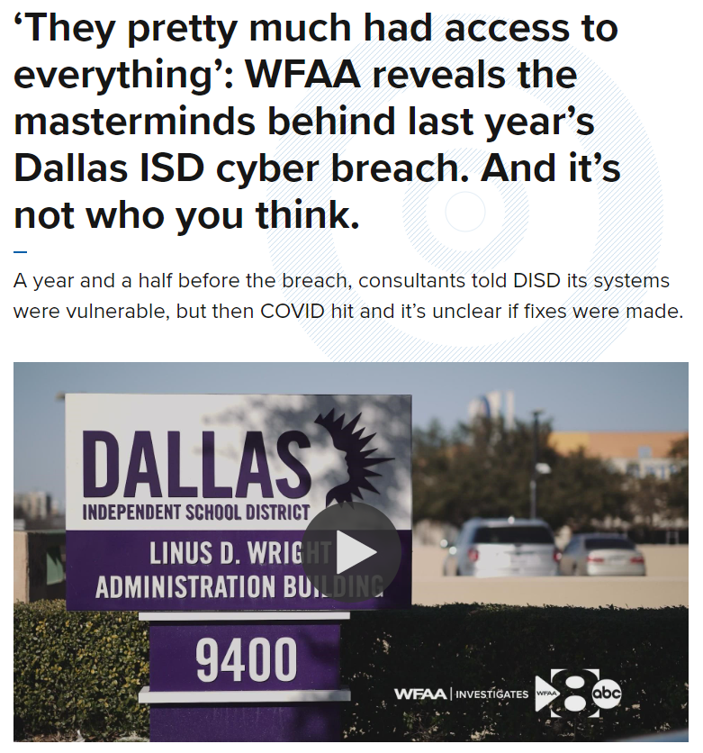
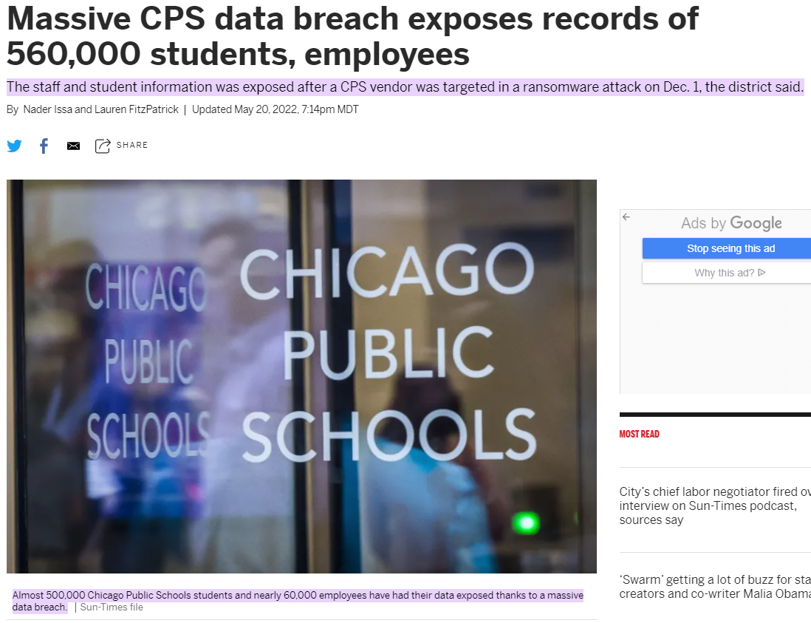
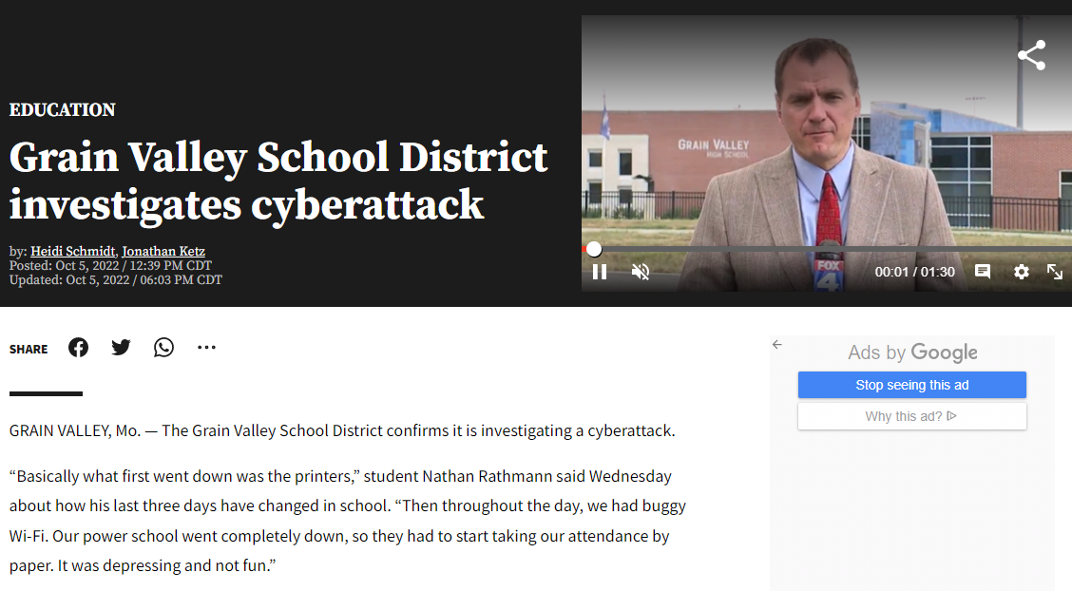
2022 Looking Back
Notes:
A brief look at some of the higher profile Education-related data breaches in 2022.
LEFT PICTURE: Dallas Independent School District hacked by 2 students. Lesson learned: The School District was told by consultants a year prior about vulnerabilities, but did not remediate them.
MIDDLE PICTURE: Chicago Public Schools teacher evaluation vendor Battelle for Kids hit by ransomware. Lesson learned: Better vendor oversight is needed.
RIGHT PICTURE: Grain Valley School District computer networks brought down by cyberattack (no data breach). Lesson learned: it’s not just the confidentiality of information that we must protect – we must also make sure our computer systems are available when we need them.

Slide 5
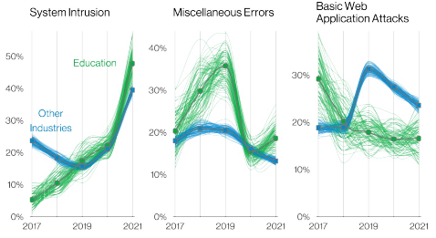
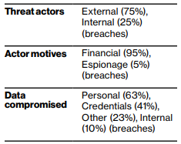
2023 Looking Forward
Notes:
LEFT GRAPHIC: These 3 types of incidents cause 80% of all incidents in this sector. Lessons Learned:
1. System Intrusion: we need to protect our own computers.
2. Miscellaneous Errors: we need to make sure we are not doing things like emailing things to the wrong people.
3. Basic Web Application Attacks: we need to make sure our vendors which provide us with Internet-facing capabilities are protecting the systems appropriately.
RIGHT GRAPHIC: Threat Actor Types, Motivations & Goals. Lessons Learned:
1. Internal Threats are more “real” for Education (25% compared to 18% average) – why? Students!!!
2. Financial motivations are #1 (you can sell the data you steal).
3. Personal information is followed closely by credentials in terms of what is stolen.

Slide 6
Data Protection Regulation & Resources
Regulations
European Union:
General Data Protection Regulation (GDPR) of 2016
United States:
Family Educational Rights and Privacy Act (FERPA) of 1974
Parent Access to Records
Disclosure Requirements
K-12 Cybersecurity Act of 2021
Voluntary Guidelines from CISA
Jamaica:
The Data Protection Act, 2020
Resources
International:
Center for Internet Security:
Technical Guidance
K12 SIX (Security Information eXchange):
Cybersecurity Frameworks
Essential Cybersecurity Protections Annual Report
Cybersecurity District Self-Assessment Tool
Essential Cyber Incident Response Runbook
U.S.-specific:
State & Local Cybersecurity
Grant Program
Notes:
Talk about
(1) What governments have done to try and set a minimum standard for protecting data
(2) What organizations have done to provide free (or inexpensive) resources to help cash-strapped entities comply with regulations

Slide 7
Jamaica Data Protection Act, 2020
Key Terms:
Data Controller
Data Processor
Personal Data
Sensitive Data
Health Data
Biometric Data
8 Standards:
Fairness & Lawfulness
Purpose Limitation
Data Minimization
Accuracy
Data Retention
Rights of Data Subject
Specific Security Controls - Encryption - CIA & Resilience - Backups - Control Testing
Cross-Border Transfers
Caveats:
Misconception that if you are using a compliant Product, you are 100% compliant.
Notes:
Brief overview of the Data Protection Act; NOT intended to be in-depth.
The point: This is a commonsense, well-grounded law that is not impossible to comply with.

Slide 8
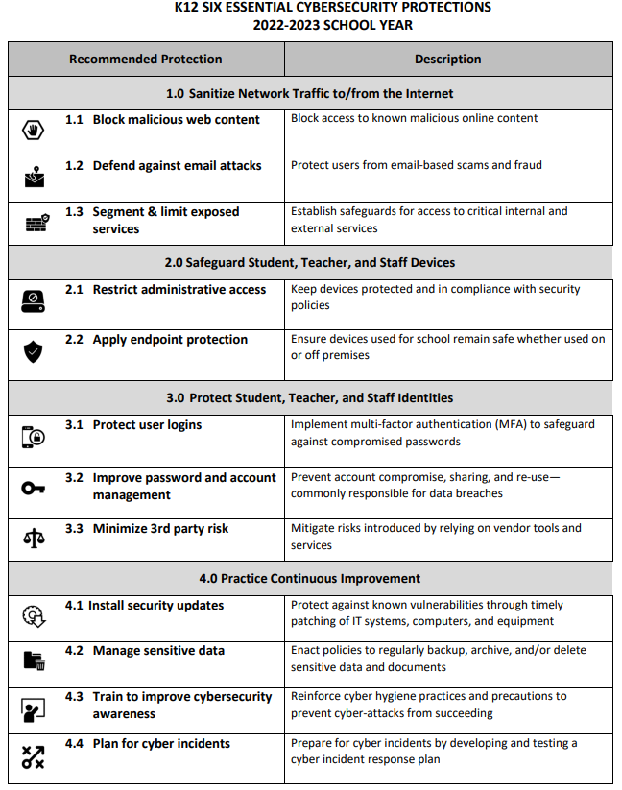
Practical Advice
Securing the Human:
Organizational Culture (starts at the top)
Security Awareness (e.g., locking unattended systems)
Data Minimization:
If you don't need it, don't ask for it.
If you do need it:
Protect it with reasonable controls.
Get rid of it as soon as you can.
Notes:
Talk about how you can do SO MANY things to help protect data without spending a lot of money (or any money at all, in some cases!)
LEFT GRAPHIC: 12 recommendations for K12 educational organizations to protect their systems & data.

Slide 9
The Silver Lining
Say No to FUD!
Don’t Be Scared of “The Cloud”
School in Philippines
Resources Are Available!
Digital technology has become a social necessity to ensure education as a basic human right, especially in a world experiencing more frequent crises and conflicts. During the COVID-19 pandemic, countries without sufficient ICT infrastructure and well-resourced digital learning systems suffered the greatest education disruptions and learning losses. This situation left as many as one third of students around the world without access to learning during the school closures for more than a year. – UNESCO
In short, the benefits of technology outweigh the risks!
Notes:
The point of this slide is two-fold:
To remind the audience that even though there is risk involved with the continued transition of education into high-tech, there is even greater reward.
Those that choose to remain in the past can still lose their systems and data to “basic” things like fire, vandalism, or theft.

Slide 10
Thank You!
Additional Information:
Advice & Informational Resources:
K12 Security Information eXchange: https://www.k12six.org/
The Center for Internet Security: https://www.cisecurity.org/
U.S. Cybersecurity & Infrastructure Security Agency K-12 Resources: https://www.cisa.gov/stopransomware/k-12-resources
Security Incident Data:
Education Industry Data Breaches: https://www.databreaches.net/category/breach-reports/education-sector/
Verizon Data Breach Investigations Report: https://www.verizon.com/business/resources/T17f/reports/dbir/2022-data-breach-investigations-report-dbir.pdf
Regulations & International Programs
The Data Protection Act, 2020: https://japarliament.gov.jm/attachments/article/339/The%20Data%20Protection%20Act,%202020.pdf
UNESCO Digital Learning & Transformation of Education: https://www.unesco.org/en/digital-education
International Association of Privacy Professionals (IAPP): https://iapp.org/

